Slide 1
Signup flow for new product
I worked on the signup flow for a new product that puts your pills into packets for easy use. “Never miss a dose.”
Initially, we were allowing guest users (users did not have to list their Rxs and could skip a lot of the questions). Since this relied on a representative later inputting the information, the flow was revamped so more information was collected during the process.
The language was written with the new directive towards a friendlier, more emphatic tone.

Slide 2
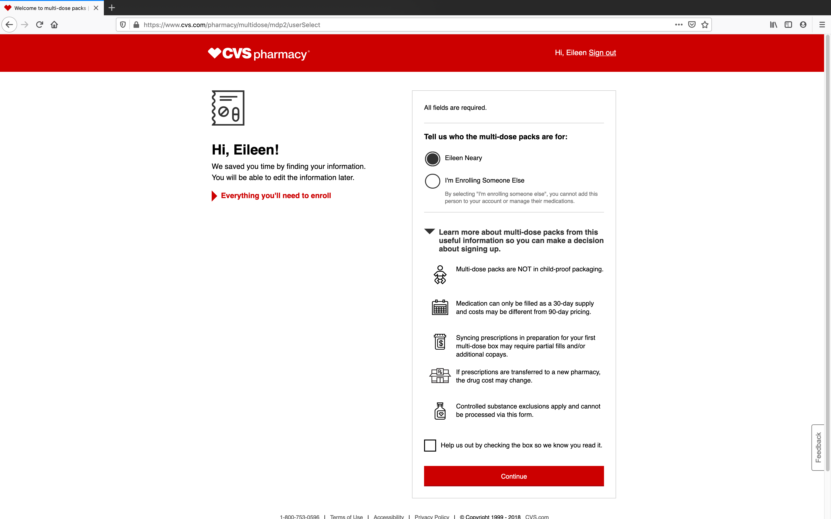

Slide 3
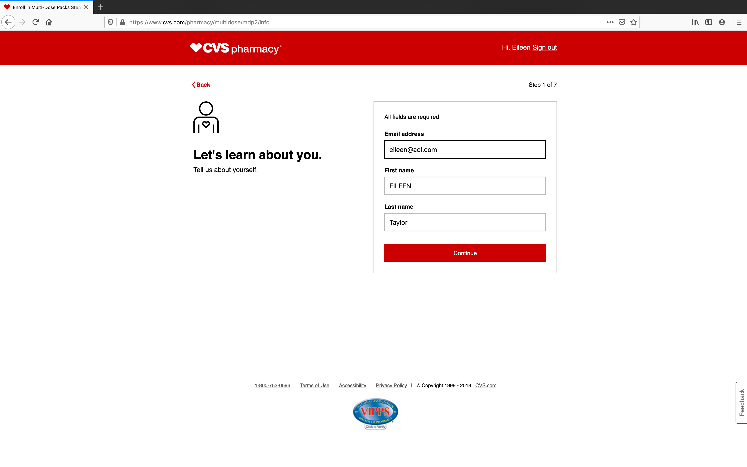
Let’s learn about you

Slide 4
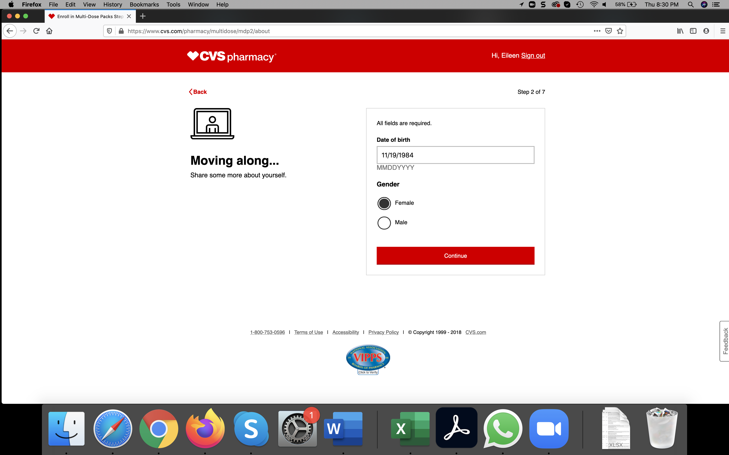
Moving along….

Slide 5
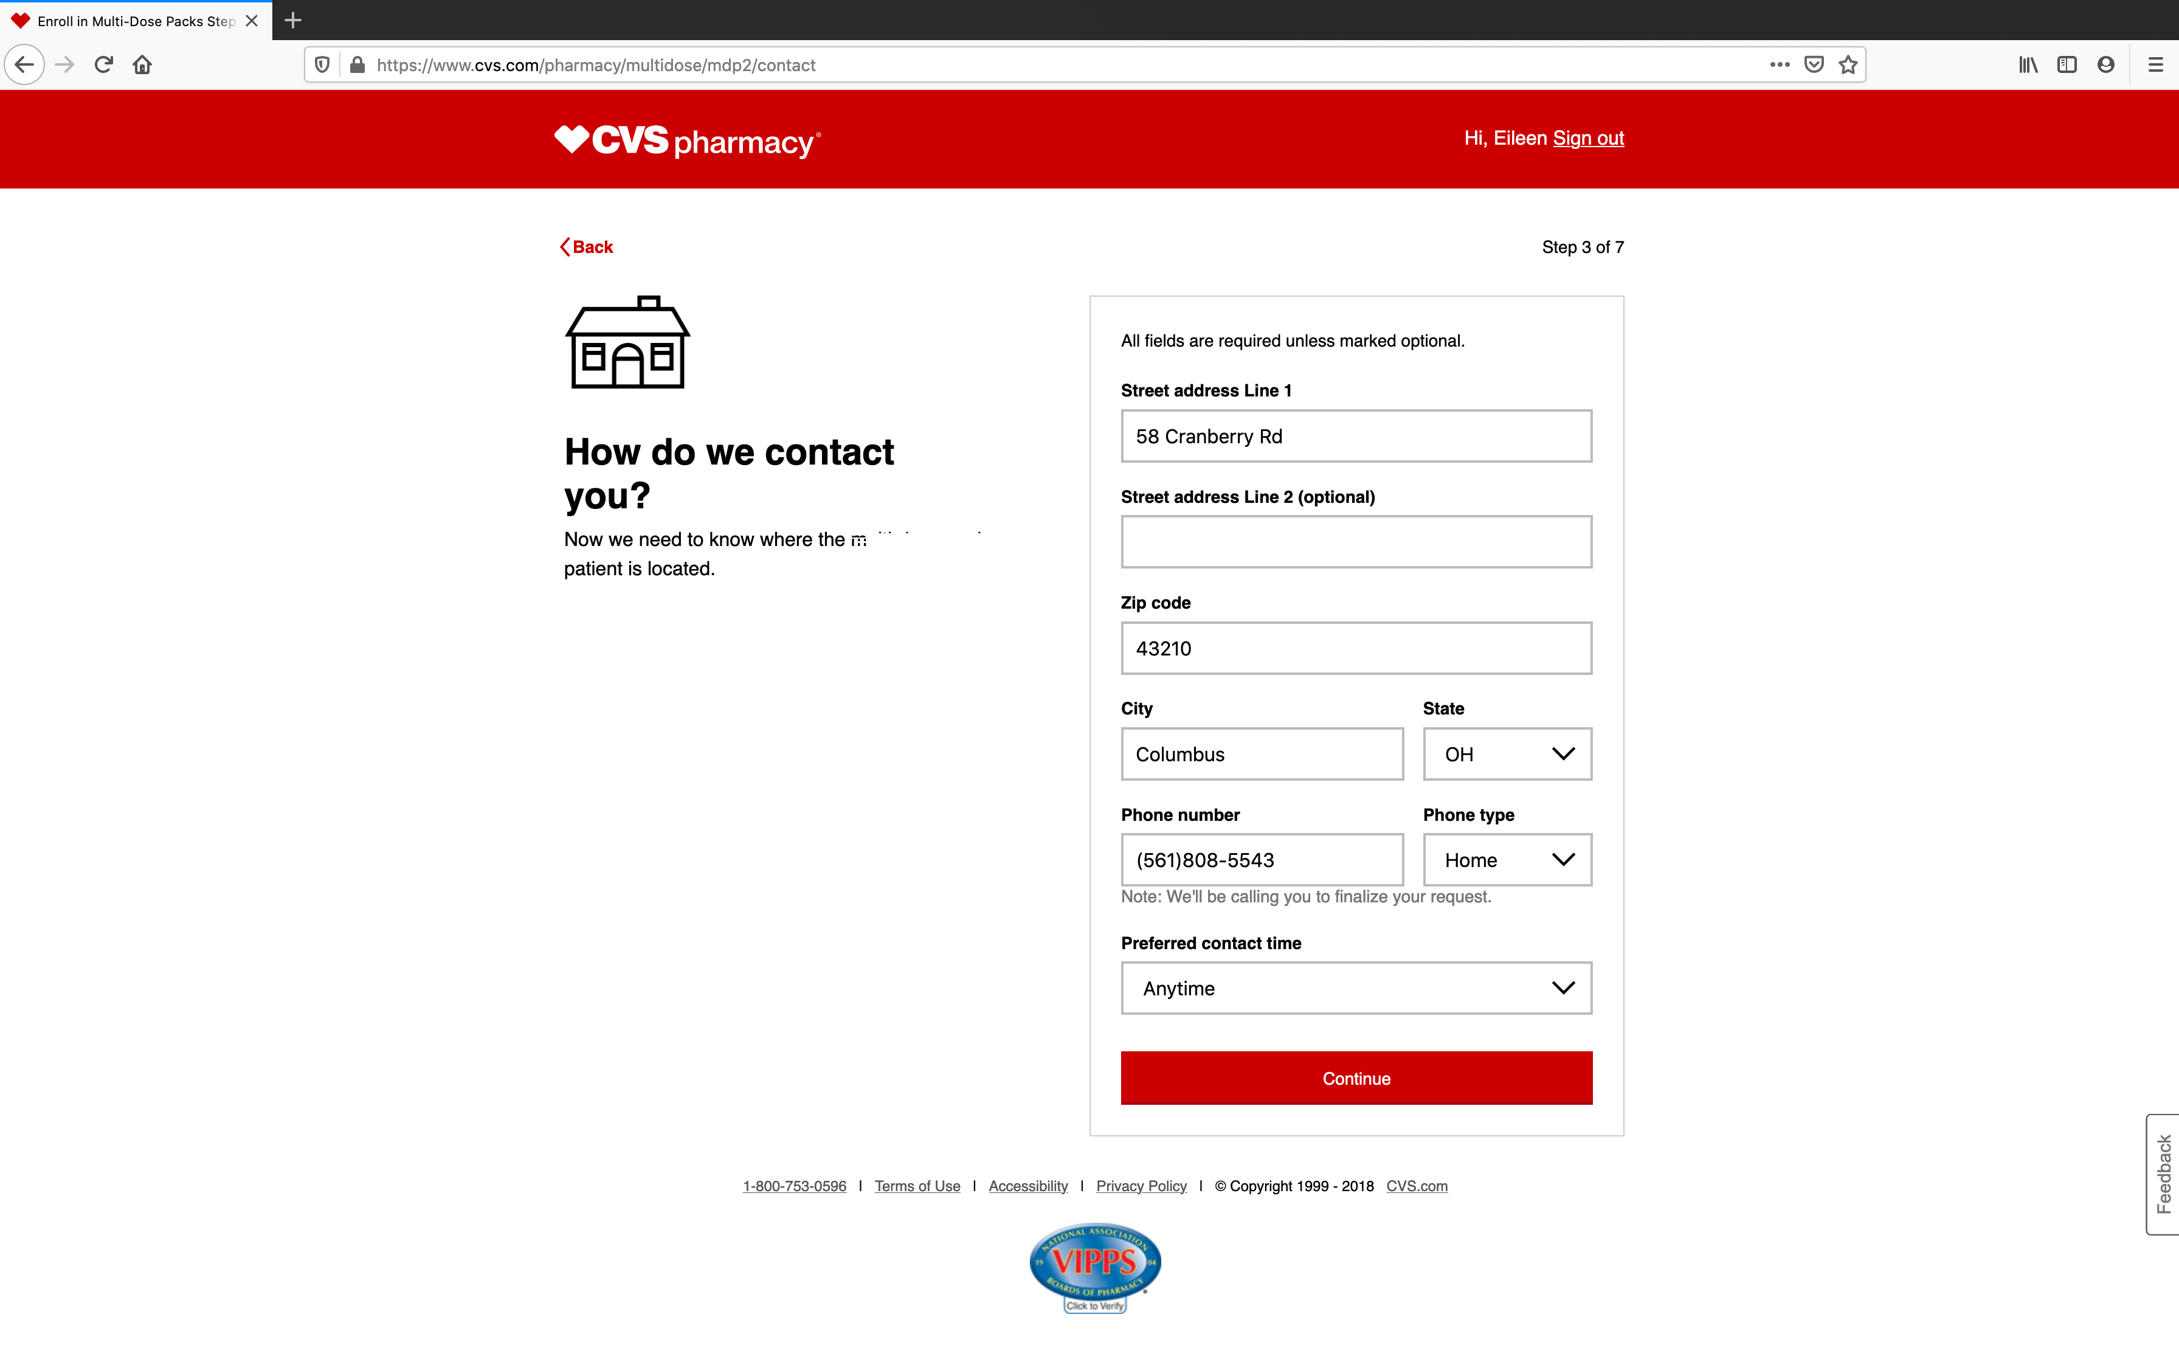
Contact

Slide 6
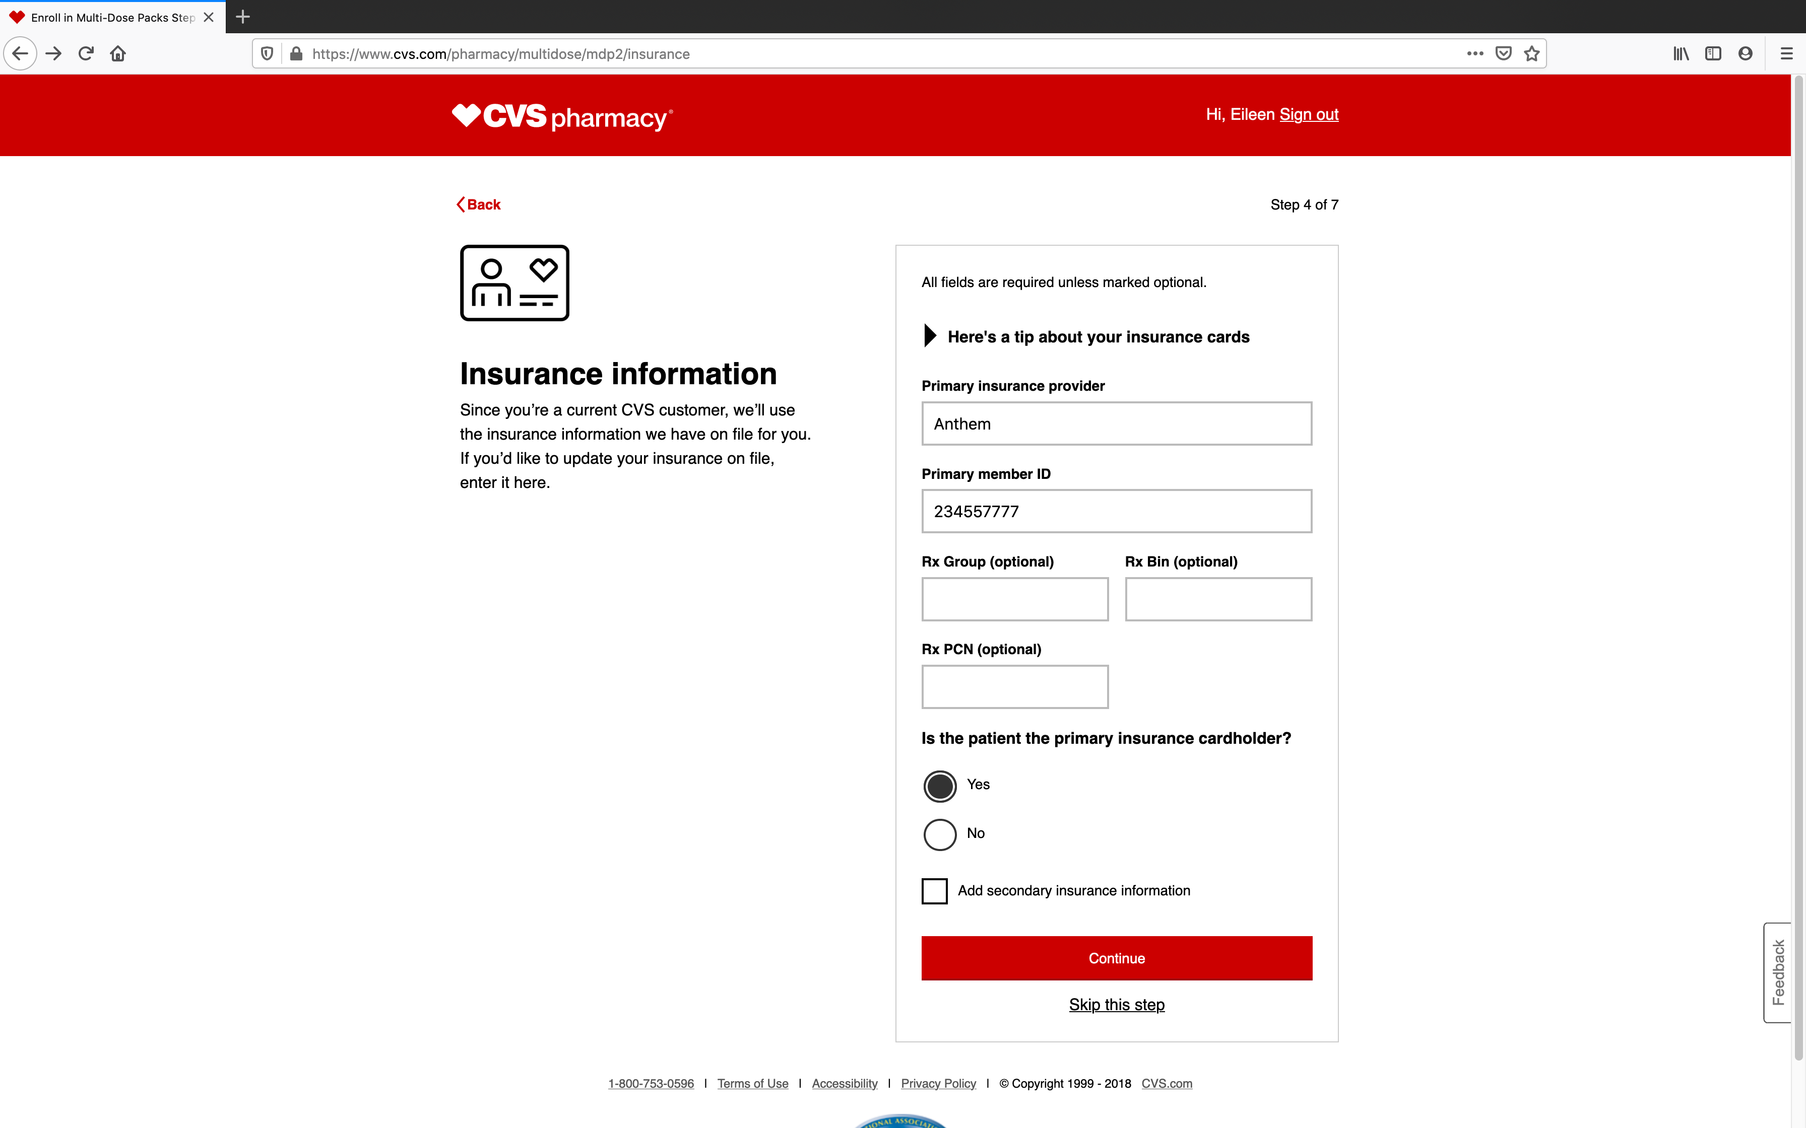
Insurance information

Slide 7
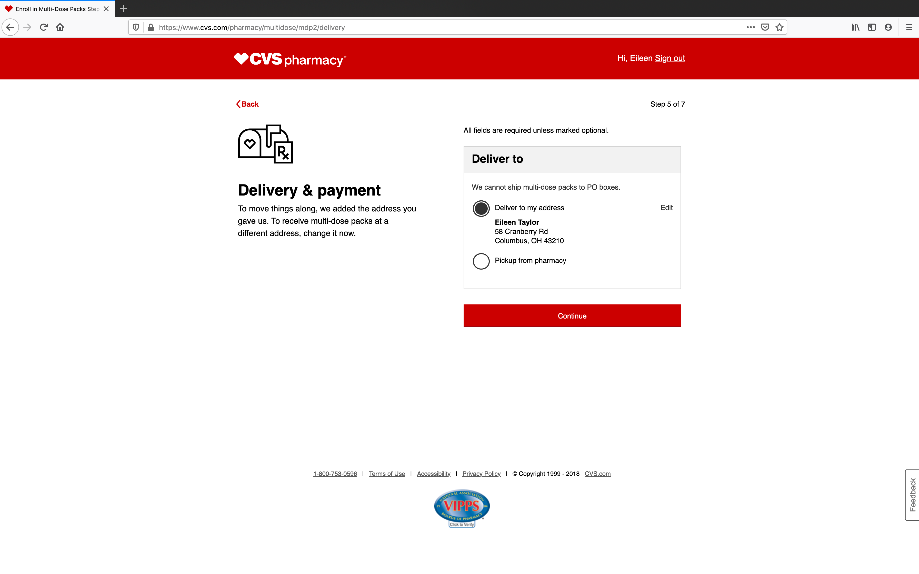
Delivery & Payment

Slide 8
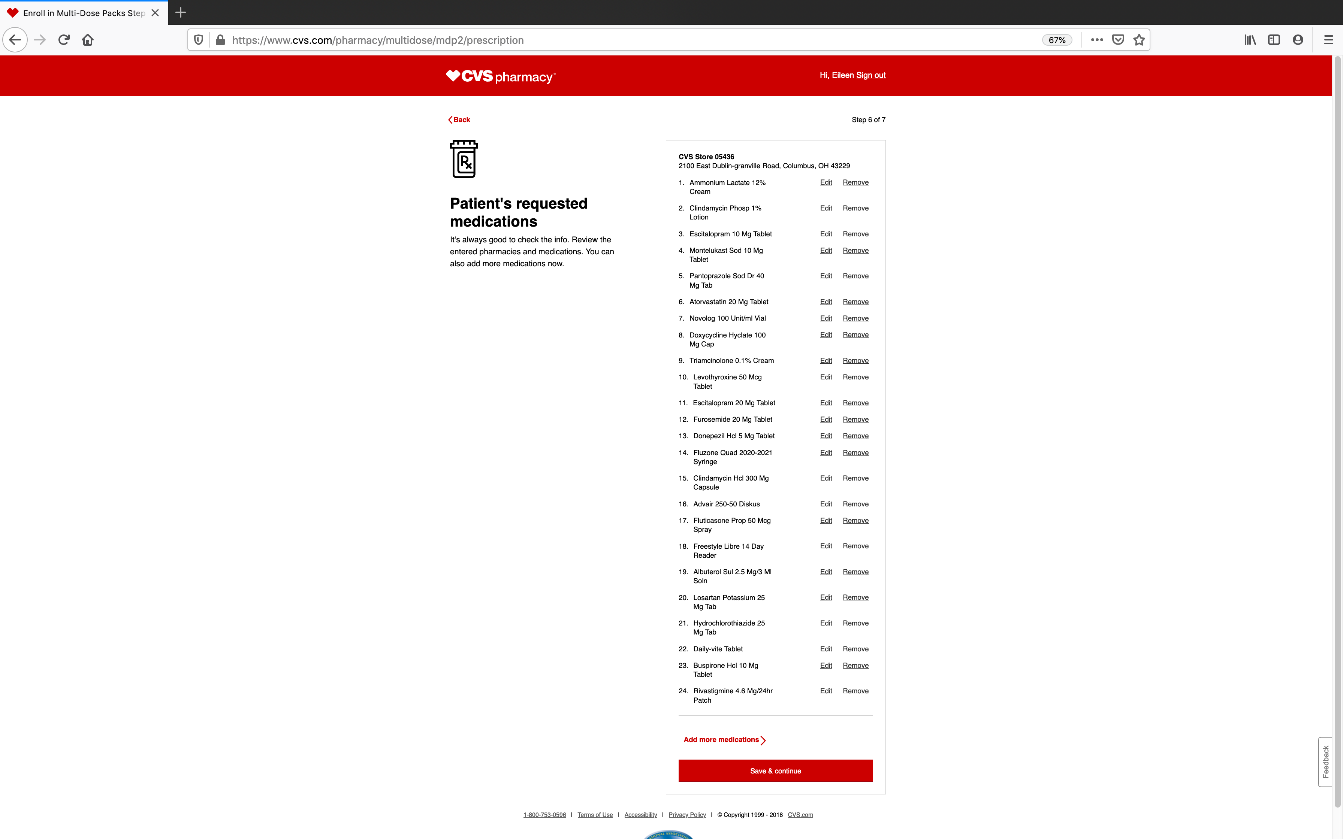
Medications

Slide 9
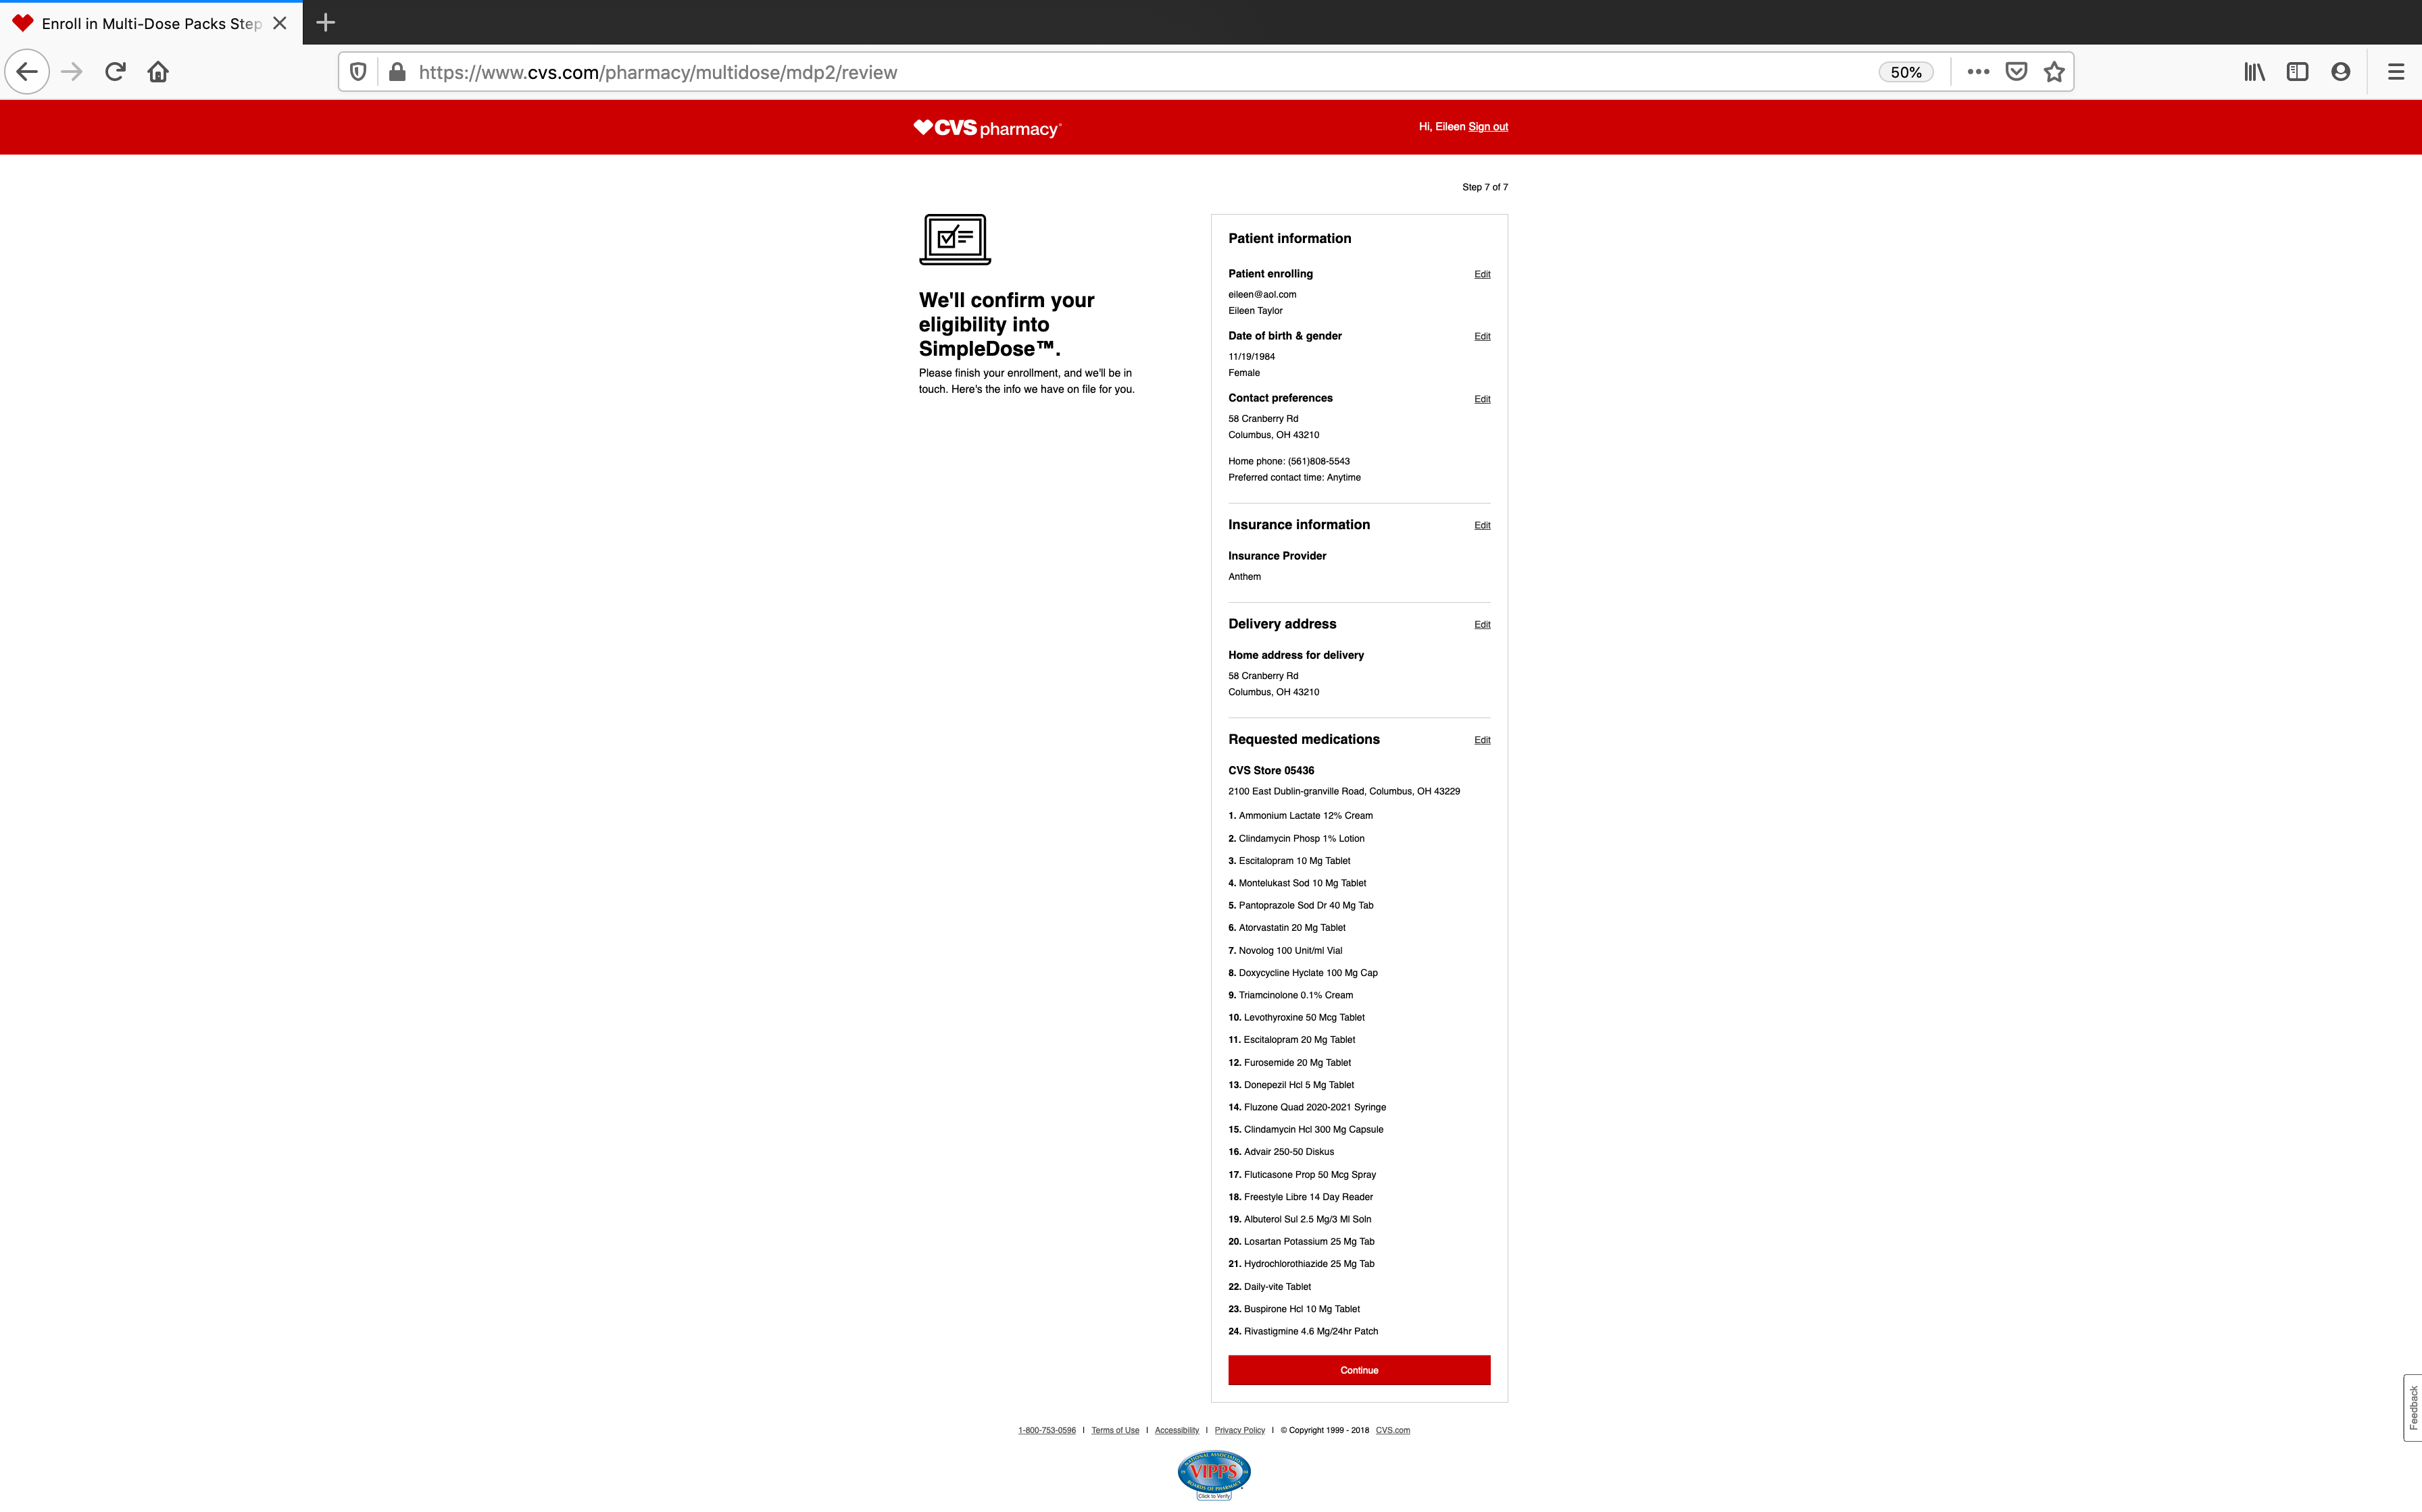

Slide 10
